Slide 1
Electronic Communication Systems

Slide 2
UNIT – I INTRODUCTION TO COMMUNICATION AND NETWORKING
Introduction To Communication Theory: Terminologies, Elements of Analog Communication System, Baseband signal, Band-pass signal, Need For Modulation, Electromagnetic Spectrum And Typical Applications, Basics of Signal (Analog And Digital,) Representation And Analysis (Time and frequency)
Introduction To basics of networking: Computer network fundamentals, ISO OSI Model: All Layers, TCP/IP Protocol Suite: All Layers, Addressing (Physical, Logical Port and Other), LAN, WAN And MAN, Network Topologies. Guided Media: Twisted-Pair Cable, Coaxial Cable and Fiber-Optic Cable, Unguided Media: Wireless, Radio Waves, Microwaves And Infrared, Wireless frequency spectrum.
Noise: External Noise, Internal Noise, Noise Calculations, Communication Channel. Discrete and Continuous Channel, Shannon-Hartley Theorem, Channel Capacity, Nyquist and Shanon Theorem, Bandwidth S/N Trade Off

Slide 3
Period and Frequency
Period refers to the amount of time, in seconds, a signal needs to complete 1 cycle.
Frequency refers to the number of periods in 1 s.
Frequency and period are the inverse of each other.
f = 1 / T.

Slide 4
Significance of Human Communication
Communication is the process of exchanging information.
Main barriers are language and distance.
Contemporary society’s emphasis is now the accumulation, packaging, and exchange of information.

Slide 5
Significance of Human Communication
Methods of communication:
Face to face
Signals
Written word (letters)
Electrical innovations:
Telegraph
Telephone
Radio
Television
Internet (computer)

Slide 6
Communication Systems
Basic components:
Transmitter
Channel or medium
Receiver
Noise degrades or interferes with transmitted information.

Slide 7
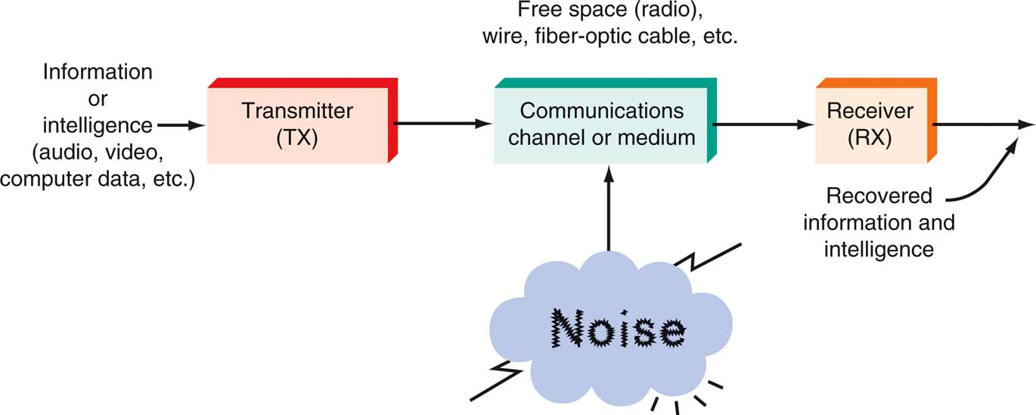
Communication Systems
A general model of all communication systems.

Slide 8
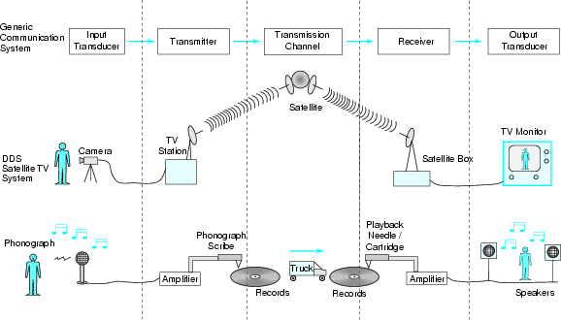
Examples of Communication

Slide 9
Elements of Communication Systems
Information:
The communication system exists to convey a message.
Message comes from information source.
Information forms - audio, video, text or data.

Slide 10
Communication Systems
Transmitter
Processes input signal to produce a transmitted signal that suited the characteristic of transmission channel.
E.g. modulation, coding, mixing, translate
Other functions performed - Amplification, filtering, antenna
Message converted to into electrical signals by transducers
E.g. speech waves are converted to voltage variation by a microphone
The transmitter is a collection of electronic components and circuits that converts the electrical signal into a signal suitable for transmission over a given medium.
Transmitters are made up of oscillators, amplifiers, tuned circuits and filters, modulators, frequency mixers, frequency synthesizers, and other circuits.

Slide 11
Communication Systems
Communication Channel (transmission media):
A medium that bridges the distance from source to destination. e.g.: Atmosphere (free space), coaxial cable, fiber optics, waveguide
Signals undergoes degradation from noise , interference and distortion.
The communication channel is the medium by which the electronic signal is sent from one place to another.
Types of media include
Electrical conductors
Optical media
Free space
System-specific media (e.g., water is the medium for sonar).

Slide 12
Communication Systems
Receivers
To recover the message signal contained in the received signal from the output of the channel, and convert it to a form suitable for the output transducer.
e.g. mixing, demodulation, decoding
Other functions performed: Amplification, filtering.
Transducer converts the electrical signal at its input into a form desired by the system used
A receiver is a collection of electronic components and circuits that accepts the transmitted message from the channel and converts it back into a form understandable by humans.
Receivers contain amplifiers, oscillators, mixers, tuned circuits and filters, and a demodulator or detector that recovers the original intelligence signal from the modulated carrier.

Slide 13
Communication Systems
Transceivers
A transceiver is an electronic unit that incorporates circuits that both send and receive signals.
Examples are:
Telephones
Fax machines
Handheld CB radios
Cell phones
Computer modems

Slide 14
Communication Systems
Attenuation
Signal attenuation, or degradation, exists in all media of wireless transmission. It is proportional to the square of the distance between the transmitter and receiver.

Slide 15
Communication Systems
Noise
Noise is random, undesirable electronic energy that enters the communication system via the communicating medium and interferes with the transmitted message.

Slide 16
Types of Electronic Communication
Electronic communications are classified according to whether they are
One-way (simplex) or two-way (full duplex or half duplex) transmissions
Analog or digital signals.

Slide 17
Types of Electronic Communication
Simplex
The simplest method of electronic communication is referred to as simplex.
This type of communication is one-way. Examples are:
Radio
TV broadcasting
Beeper (personal receiver)

Slide 18
Types of Electronic Communication
Full Duplex
Most electronic communication is two-way and is referred to as duplex.
When people can talk and listen simultaneously, it is called full duplex. The telephone is an example of this type of communication.

Slide 19
Types of Electronic Communication
Half Duplex
The form of two-way communication in which only one party transmits at a time is known as half duplex. Examples are:
Police, military, etc. radio transmissions
Citizen band (CB)
Family radio
Amateur radio

Slide 20
Types of Electronic Communication
Analog Signals
An analog signal is a smoothly and continuously varying voltage or current. Examples are:
Sine wave
Voice
Video (TV)
the informative signal is transmitted in continuous form

Slide 21
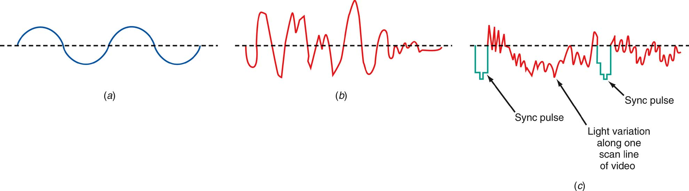
Types of Electronic Communication
Analog signals (a) Sine wave “tone.” (b) Voice. (c) Video (TV) signal.

Slide 22
Types of Electronic Communication
Digital Signals
Digital signals change in steps or in discrete increments.
Most digital signals use binary or two-state codes. Examples are:
Telegraph (Morse code)
Continuous wave (CW) code
Serial binary code (used in computers)
Digital communication system: the informative signal is represented as a sequence of limited set of symbols (digits) and these symbols are transmitted via the channel by applying of and appropriate modulation.
Basic advantages of the digital communication systems:
better resistivity against the noise;
allows the use of effective coding methods;
more flexible signal handling suggested by digital signal processing methods.

Slide 23
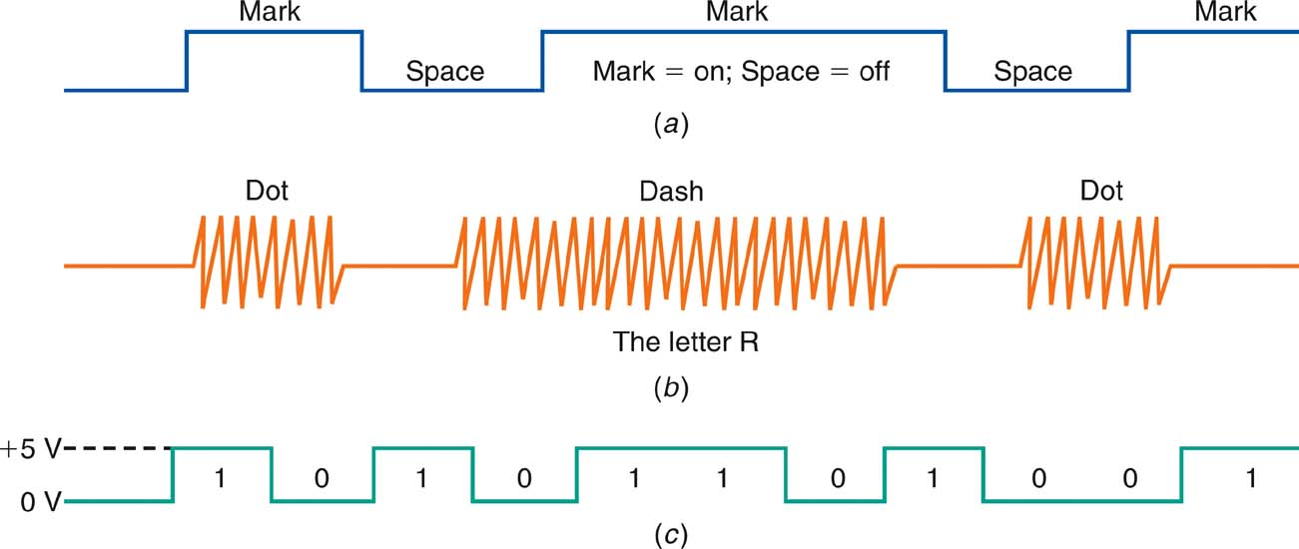
Types of Electronic Communication
Digital signals (a) Telegraph (Morse code). (b) Continuous-wave (CW) code. (c) Serial binary code.

Slide 24
Types of Electronic Communication
Digital Signals
Many transmissions are of signals that originate in digital form but must be converted to analog form to match the transmission medium.
Digital data over the telephone network.
Analog signals.
They are first digitized with an analog-to-digital (A/D) converter.
The data can then be transmitted and processed by computers and other digital circuits.

Slide 25
Modulation
What is modulation?
A process of changing one or more properties of the analog carrier in proportion to the information signal.
One of the characteristics of the carrier signal is changed according to the variations of the modulating signal.
AM – amplitude, E
FM – frequency , ω
PM - phase , θ
Why modulation is needed?
To generate a modulated signal suited and compatible to the characteristics of the transmission channel.
For ease radiation and reduction of antenna size
Reduction of noise and interference
Channel assignment
Increase transmission speed

Slide 26
Modulation and Multiplexing
Modulation and multiplexing are electronic techniques for transmitting information efficiently from one place to another.
Modulation makes the information signal more compatible with the medium.
Multiplexing allows more than one signal to be transmitted concurrently over a single medium.

Slide 27
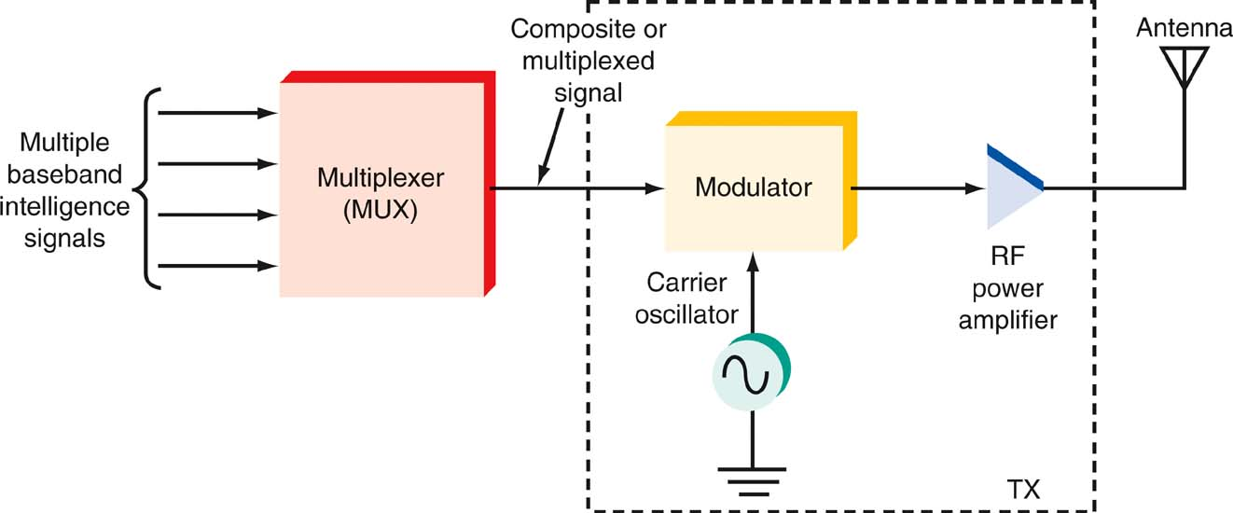
Modulation and Multiplexing
Multiplexing at the transmitter.

Slide 28
The Electromagnetic Spectrum
The range of electromagnetic signals encompassing all frequencies is referred to as the electromagnetic spectrum.

Slide 29
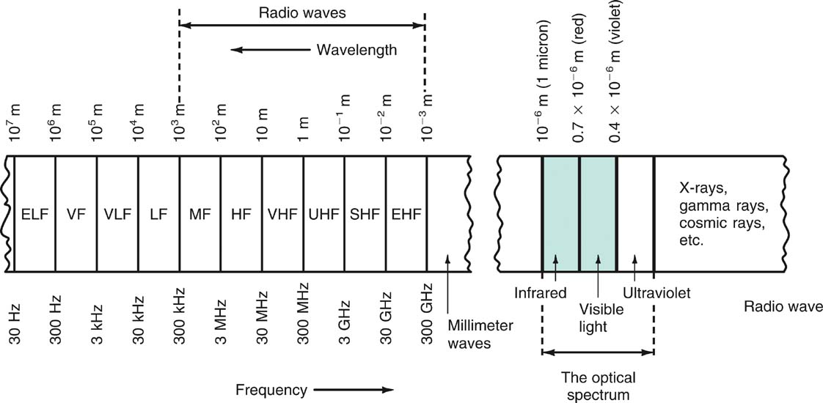
The Electromagnetic Spectrum
The electromagnetic spectrum.

Slide 30
The Electromagnetic Spectrum
Frequency and Wavelength: Frequency
A signal is located on the frequency spectrum according to its frequency and wavelength.
Frequency is the number of cycles of a repetitive wave that occur in a given period of time.
A cycle consists of two voltage polarity reversals, current reversals, or electromagnetic field oscillations.
Frequency is measured in cycles per second (cps).
The unit of frequency is the hertz (Hz).

Slide 31
The Electromagnetic Spectrum
Frequency and Wavelength: Wavelength
Wavelength is the distance occupied by one cycle of a wave and is usually expressed in meters.
Wavelength is also the distance traveled by an electromagnetic wave during the time of one cycle.
The wavelength of a signal is represented by the Greek letter lambda (λ).

Slide 32
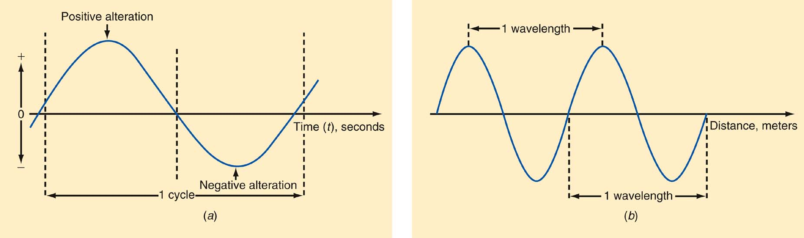
The Electromagnetic Spectrum
Frequency and wavelength. (a) One cycle. (b) One wavelength.

Slide 33
The Electromagnetic Spectrum
Frequency and Wavelength: Wavelength
Wavelength (λ) = speed of light ÷ frequency
Speed of light = 3 × 10⁸ meters/second
Therefore:
λ = 3 × 10⁸ / f
Example:
What is the wavelength if the frequency is 4MHz?
λ = 3 × 10⁸ / 4 MHz
= 75 meters (m)

Slide 34
The Electromagnetic Spectrum
Frequency Ranges from 30 Hz to 300 GHz
The electromagnetic spectrum is divided into segments:
Extremely Low Frequencies (ELF) | 30–300 Hz.
Voice Frequencies (VF) | 300–3000 Hz.
Very Low Frequencies (VLF) | include the higher end of the human hearing range up to about 20 kHz.
Low Frequencies (LF) | 30–300 kHz.
Medium Frequencies (MF) | 300–3000 kHz AM radio 535–1605 kHz.

Slide 35
The Electromagnetic Spectrum
Frequency Ranges from 30 Hz to 300 GHz
High Frequencies (HF) (short waves; VOA, BBC broadcasts; government and military two-way communication; amateur radio, CB. | 3–30 MHz
Very High Frequencies (VHF) FM radio broadcasting (88–108 MHz), television channels 2–13. | 30–300 MHz
Ultra High Frequencies (UHF) TV channels 14–67, cellular phones, military communication. | 300–3000 MHz

Slide 36
The Electromagnetic Spectrum
Frequency Ranges from 30 Hz to 300 GHz
Microwaves and Super High Frequencies (SHF) Satellite communication, radar, wireless LANs, microwave ovens | 1–30 GHz
Extremely High Frequencies (EHF) Satellite communication, computer data, radar | 30–300 GHz

Slide 37
The Electromagnetic Spectrum
Optical Spectrum
The optical spectrum exists directly above the millimeter wave region.
Three types of light waves are:
Infrared
Visible spectrum
Ultraviolet

Slide 38
The Electromagnetic Spectrum
Optical Spectrum: Infrared
Infrared radiation is produced by any physical equipment that generates heat, including our bodies.
Infrared is used:
In astronomy, to detect stars and other physical bodies in the universe,
For guidance in weapons systems, where the heat radiated from airplanes or missiles can be detected and used to guide missiles to targets.
In most new TV remote-control units, where special coded signals are transmitted by an infrared LED to the TV receiver to change channels, set the volume, and perform other functions.
In some of the newer wireless LANs and all fiber-optic communication.

Slide 39
The Electromagnetic Spectrum
Optical Spectrum: The Visible Spectrum
Just above the infrared region is the visible spectrum we refer to as light.
Red is low-frequency or long-wavelength light
Violet is high-frequency or short-wavelength light.
Light waves’ very high frequency enables them to handle a tremendous amount of information (the bandwidth of the baseband signals can be very wide).
Optical Spectrum: Ultraviolet
Ultraviolet is not used for communication
Its primary use is medical.

Slide 40
Bandwidth
Bandwidth (BW) is that portion of the electromagnetic spectrum occupied by a signal.
Channel bandwidth refers to the range of frequencies required to transmit the desired information.

Slide 41
Gain, Attenuation, and Decibels
Most circuits in electronic communication are used to manipulate signals to produce a desired result.
All signal processing circuits involve:
Gain
Attenuation

Slide 42
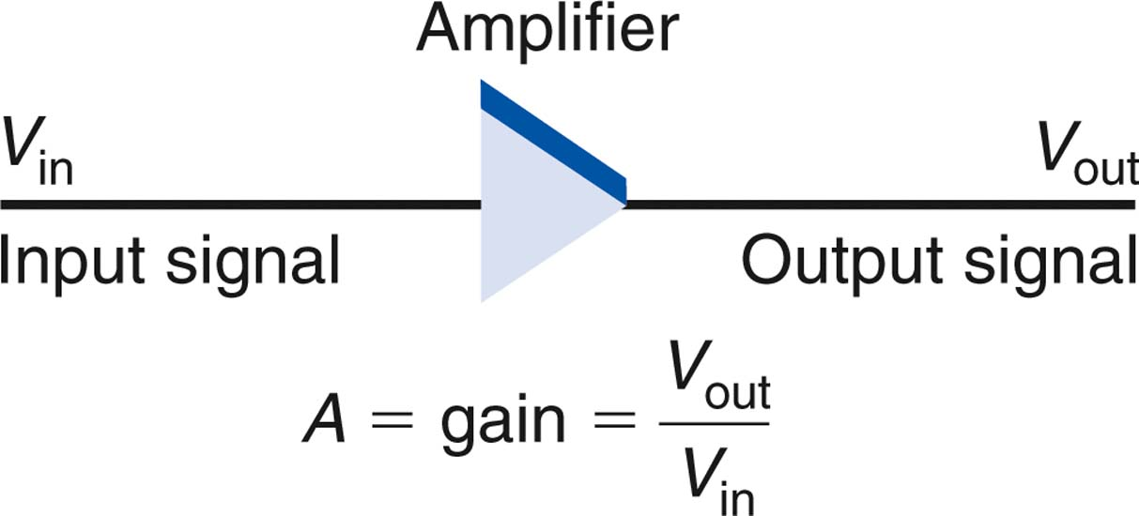
Gain, Attenuation, and Decibels
Gain
Gain means amplification. It is the ratio of a circuit’s output to its input.
output
V_{out}
A_{V} =
=
input
V_{in}
An amplifier has gain.

Slide 43
Gain, Attenuation, and Decibels
Most amplifiers are also power amplifiers, so the same procedure can be used to calculate power gain A_{P} where P_{in} is the power input and P_{out} is the power output.
Power gain (A_{p}) = P_{out} / P_{in}
Example:
The power output of an amplifier is 6 watts (W). The power gain is 80. What is the input power?
A_{p} = P_{out} / P_{in} therefore P_{in} = P_{out} / A_{p}
P_{in} = 6 / 80 = 0.075 W = 75 mW

Slide 44
Gain, Attenuation, and Decibels
An amplifier is cascaded when two or more stages are connected together.
The overall gain is the product of the individual circuit gains.
Example:
Three cascaded amplifiers have power gains of 5, 2, and 17. The input power is 40 mW. What is the output power?
A_{p} = A₁ × A₂ × A₃ = 5 × 2 × 17 = 170
A_{p} = P_{out} / P_{in} therefore P_{out} = A_{p}P_{in}
P_{out} = 170 (40 × 10⁻³) = 6.8W

Slide 45
Gain, Attenuation, and Decibels
Attenuation
Attenuation refers to a loss introduced by a circuit or component. If the output signal is lower in amplitude than the input, the circuit has loss or attenuation.
The letter A is used to represent attenuation
Attenuation A = output/input = V_{out}/V_{in}
Circuits that introduce attenuation have a gain that is less than 1.
With cascaded circuits, the total attenuation is the product of the individual attenuations.

Slide 46
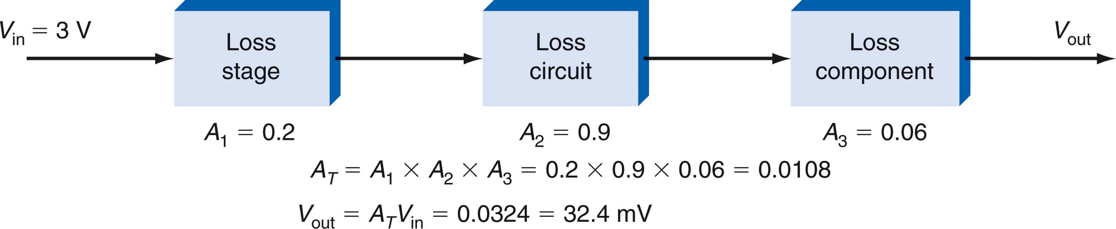
Gain, Attenuation, and Decibels
Total attenuation is the product of individual attenuations of each cascaded circuit.

Slide 47
Gain, Attenuation, and Decibels
Decibels
The decibel (dB) is a unit of measure used to express the gain or loss of a circuit.
The decibel was originally created to express hearing response.
A decibel is one-tenth of a bel.
When gain and attenuation are both converted into decibels, the overall gain or attenuation of a circuit can be computed by adding individual gains or attenuations, expressed in decibels.

Slide 48
Gain, Attenuation, and Decibels
Decibels: Decibel Calculations
Voltage Gain or Attenuation
dB = 20 log V_{out}/ V_{in}
Current Gain or Attenuation
dB = 20 log I_{out}/ I_{in}
Power Gain or Attenuation
dB = 10 log P_{out}/ P_{in}

Slide 49
Gain, Attenuation, and Decibels
Decibels: Decibel Calculations
Example:
An amplifier has an input of 3 mV and an output of 5 V. What is the gain in decibels?
dB = 20 log 5/0.003
= 20 log 1666.67
= 20 (3.22)
= 64.4

Slide 50
Gain, Attenuation, and Decibels
Decibels: Decibel Calculations
Example:
A filter has a power input of 50 mW and an output of 2 mW. What is the gain or attenuation?
dB = 10 log (2/50)
= 10 log (0.04)
= 10 (−1.398)
= −13.98
If the decibel figure is positive, that denotes a gain.

Slide 51
THE ELECTROMAGNETIC SPECTRUM FROM 30 HZ TO 300 GHZ
Wavelength
(λ = 300/f)
10⁷ m
10⁶ m
10⁵ m
10⁴ m
10³ m
10² m
10 m
10⁻¹ m
10⁻² m
10⁻³ m
10⁻⁴ m
1 m
ELF
VLF
LF
MF
HF
VHF
UHF
SHF
EHF
Millimeter
waves
VF
30 Hz
300 Hz
3 kHz
30 kHz
3 MHz
3 GHz
30 GHz
300 kHz
30 MHz
300 MHz
300 GHz
(f = 300/λ)
Frequency

Slide 52
LOW AND MEDIUM FREQUENCIES
Extremely Low Frequencies - 30 to 300 Hz
Voice Frequencies - 300 to 3000 Hz
Very Low Frequencies - 3 kHz to 30 kHz
Low Frequencies - 30 kHz to 300 kHz
Medium Frequencies - 300 kHz to 3 MHz

Slide 53
HIGH FREQUENCIES
High Frequencies
- 3 MHz to 30 MHz
Very High Frequencies
- 30 MHz to 300 MHz
Ultra High Frequencies
- 300 MHz to 3 GHz
(1 GHz and above = microwaves)
Super High Frequencies
- 3 GHz to 30 GHz
Extremely High Frequencies
- 30 GHz to 300 GHz

Slide 54
THE ELECTROMAGNETIC SPECTRUM ABOVE 300 GHZ
Wavelength
0.8 x 10⁻⁶ m
0.4 x 10⁻⁶ m
10⁻³ m
10⁻⁴ m
10⁻⁵ m
Millimeter
waves
Ultraviolet
Infrared
Visible
X-rays
Gamma rays
Cosmic rays
300 GHz

Slide 55
TYPES OF COMMUNICATIONS
TX
Channel
RX
Simplex:
One-way
Duplex:
Two-way
Half duplex:
Alternate TX/RX
Full duplex:
Simultaneous
TX/RX
TX
RX
Channel(s)
RX
TX

Slide 56
COMMUNICATIONS SIGNAL VARIATIONS
Baseband - The original information signal such as audio, video, or computer data. Can be analog or digital.
Broadband - The baseband signal modulates or modifies a carrier signal, which is usually a sine wave at a frequency much higher than the baseband signal.

Slide 57
Various forms of communication system
Broadcast: radio and television
Mobile communications
Fixed communication system- land line
Data communication-internet

Slide 58
Frequency Spectrum &Bandwidth
The frequency spectrum of a waveform consists of all frequencies contained in the waveform and their amplitudes plotted in the frequency domain.
The bandwidth of a frequency spectrum is the range of of frequencies contained in the spectrum.It is calculated by subtracting the lowest frequency from the highest.

Slide 59
Frequency Spectrum &Bandwidth (cont’d)
Bandwidth of the information signal equals to the difference between the highest and lowest frequency contained in the signal.
Similarly, bandwidth of communication channel is the difference between the highest and lowest frequency that the channel allow to pass through it

Slide 60
Noise
Noise may be defined as any unwanted introduction of energy tending to interfere with the proper reception and reproduction of transmitted signals.
Noise may be subdivided according to –type, source, effect, or relation to the receiver, depending on circumstances.
Noise can be divided into two broad groups:
noise whose sources are external to the receiver, and
noise created within the receiver itself.
External noise is difficult to treat quantitatively, and there is often little that can be done about it, sort of moving the system to another location.
Radio telescopes are always located away from industry, whose processes create so much electrical noise.
International satellite earth stations are also located in noise-free valleys, where possible.
Internal noise is both more quantifiable and capable of being reduced by appropriate receiver design.

Slide 61
External Noise
Atmospheric Noise:
Perhaps the best way to become acquainted with atmospheric noise is to listen to shortwaves on a receiver which is not well equipped to receive them. Most of these sounds are the result of spurious radio waves which induce voltages in the antenna. The majority of these radio waves come from natural sources of disturbance. They represent atmospheric noise, generally called static.
Atmospheric noise consists of spurious radio signals with components distributed over a wide range of frequencies. It is propagated over the earth in the same way as ordinary radio waves of the same frequencies, so that at any point on the ground, static will be received from all thunderstorms, local and distant.
The static is likely to be more severe but less frequent if the storm is local.
The usual increase in its level takes place at night, at both broadcast and shortwave frequencies.

Slide 62
External Noise
Atmospheric Noise: Most of the strange sounds are the result of spurious radio waves which induce voltages in the antenna. The majority of these radio waves come from natural sources of disturbance. They represent atmospheric noise, generally called static.
Atmospheric noise consists of spurious radio signals with components distributed over a wide range of frequencies. It is propagated over the earth in the same way as ordinary radio waves of the same frequencies, so that at any point on the ground, static will be received from all thunderstorms, local and distant.
The usual increase in its level takes place at night, at both broadcast and shortwave frequencies.
Atmospheric noise becomes less severe at frequencies above about 30 MHz because of two separate factors.
First, the higher frequencies are limited to line-of sight propagation, i.e., less than 80 kilometers or so.
Second, the nature of the mechanism generating this noise is such that very little of it is created in the VHF range and above.

Slide 63
External Noise
Extraterrestrial Noise:
Solar noise: The sun radiates so many things our way that we should not be too surprised to find that noise is noticeable among them, again there are two types. Under normal "quiet" conditions, there is a constant noise radiation from the sun.
It radiates over a very broad frequency spectrum which includes the frequencies we use for communications.
The sun is a constantly changing star which undergoes cycles of peak activity from which electrical disturbances erupt, such as corona flares and sunspots.
Even though, the additional noise produced comes from a limited portion of the sun's surface, it may still be orders of magnitude greater than that received during periods of quiet sun.

Slide 64
External Noise
Extraterrestrial Noise:
Cosmic noise: Since distant stars are also suns and have high temperatures, they radiate RF noise in the same manner as our sun, and what they lack in nearness they nearly make up in numbers which in combination can become significant.
The noise received is called thermal (or black-body) noise and is distributed fairly uniformly over the entire sky.
We also receive noise from the centre of our own galaxy (the Milky ~ Way), from other galaxies, and from other virtual point sources such as "quasars" and "pulsars."
This galactic noise is very intense, but it comes from sources which are only points in the sky. Two of the strongest sources, which were also two of the earliest discovered, are Cassiopeia A and Cygnus A.

Slide 65
External Noise
Space Noise: Space noise is observable at frequencies in the range from about 8 MHz to somewhat above 1.43 gigahertz (1.43 GHz), the latter frequency corresponding to the 21-cm hydrogen "line." Apart from man-made noise it is the strongest component over the range of about 20 to 120 MHz. Not very much of it below 20 MHz penetrates down through the ionosphere, while its eventual disappearance at frequencies in excess of 1.5 GHz is probably governed by the mechanisms generating it, and its absorption by hydrogen in interstellar space.

Slide 66
External Noise
Industrial Noise:
Between the frequencies of 1 to 600 MHz (in urban, suburban and other industrial areas) the intensity of noise made by humans easily outstrips that created by any other source, internal or external to the receiver.
Sources like automobile and aircraft ignition, electric motors and switching equipment, leakage from high-voltage lines and a multitude of other heavy electric machines are all included. Fluorescent lights are another powerful source of such noise and therefore should not be used where sensitive receiver reception or testing is being conducted.
The nature of industrial noise is so variable that it is difficult to analyze it on any basis other than the statistical.
It does, however, obey the general principle that received noise increases as the receiver bandwidth is increased.

Slide 67
Internal Noise
Internal noise is created by any of the active or passive devices found in receivers.
Such noise is generally random, impossible to treat on an individual voltage basis, but easy to observe and describe statistically.
Because the noise is randomly distributed over the entire radio spectrum there is, on the average, as much of it at one frequency as at any other.
Random noise power is proportional to the bandwidth over which it is measured.

Slide 68
Internal Noise
Thermal-Agitation Noise: The noise generated in a resistance or the resistive component is random and is referred to as thermal, agitation, white or Johnson noise.
It is due to the rapid and random motion of the molecules (atoms and electrons) inside the component itself.
In thermodynamics, kinetic theory shows that the temperature of a particle is a way of expressing its internal kinetic energy. Thus the "temperature" of a body is the statistical root mean square (rms) value of the velocity of motion of the particles in the body.
As the theory states, the kinetic energy of these particles becomes approximately zero (i.e., their motion ceases) at the temperature of absolute zero, which is 0 K (kelvins, formerly called degrees Kelvin) and very nearly equals -273°C.

Slide 69
Internal Noise
It becomes apparent that the noise generated by a resistor is proportional to its absolute temperature, in addition to being proportional to the bandwidth over which the noise is to be measured.
Therefore,
P_{n} ∝ Tδ f = kTδ f
where k = Boltzmann'sconstant= 1.38 x 10⁻²³J(joules)/K the appropriate proportionality constant, in this case.
T = absolute temperature, K = 273 + °C
δ f = bandwidth of interest
P_{n} = maximum noise power output of a resistor
∝ = varies directly.

Slide 70
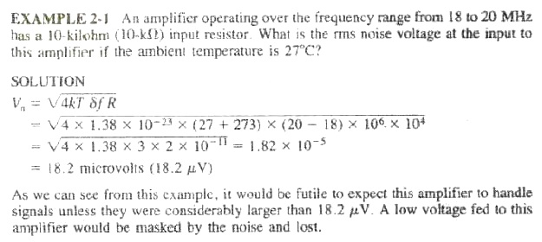
Internal Noise

Slide 71
Internal Noise
Shot Noise: The most important of all the other sources is the shot effect, which leads to shot noise in all amplifying devices and virtually all active devices.
It is caused by random variations in the arrival of electrons (or holes) at the output electrode of an amplifying device and appears as a randomly varying noise current superimposed on the output. When amplified, it is supposed to sound as though a shower of lead shot were falling on a metal sheet. Hence the name shot noise.
Although the average output current of a device is governed by the various bias voltages, at any instant of time there may be more or fewer electrons arriving at the output electrode.
Shot noise behaves in a similar manner to thermal agitation noise apart from the fact that it has a different source.

Slide 72
Internal Noise
Transit- Time Noise: If the time taken by an electron to travel from the emitter to the collector of a transistor becomes significant to the period of the signal being amplified, i.e., at frequencies in the upper VHF range and beyond, the so-called transit-time effect takes place, and the noise input admittance of the transistor increases.
Once this high-frequency noise makes its presence felt, it goes on increasing with frequency at a rate that soon approaches 6 decibels (6 dB) per octave, and this random noise then quickly predominates over the other forms.
The result of all this is that it is preferable to measure noise at such high frequencies, instead of trying to calculate an input equivalent noise resistance for it.
Radio frequency (RF) transistors have remarkably low noise i.e. a noise figure is as low as 1dB.

Slide 73
Noise Calculations
Addition of Noise due to Several Sources:
If there are two sources of thermal agitation noise generators in series
V_{n1} = sqrt (4kT Δf R₁) and V_{n2} = sqrt (4kT Δf R₂). The sum of two such rms voltages in series is given by the square root of the sum of their squares, so that we have
V_{n,tot} = sqrt (V²_{n1} + V²_{n2}) =sqrt(4kT Δf R₁₊ 4kT Δf R₂ )=sqrt(4kT Δf (R₁ + R₂)
= sqrt(4kT Δf R_{tot} )
where
R_{tot} = R₁ + R₂ + ….
It is seen from the equations that in order to find the total noise voltage caused by several sources of thermal noise in series, the resistances are added and the noise voltage is calculated using this total resistance.

Slide 74
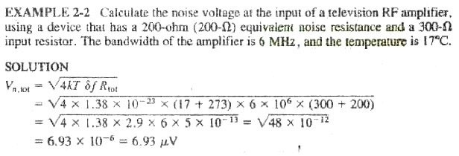
Noise Calculations
Addition of Noise due to Several Sources:
.

Slide 75

Noise Calculations
The calculation of the equivalent noise resistance of an amplifier, receiver or device may have one of two purposes or sometimes both.
The first purpose is comparison of two kinds of equipment in evaluating their performance.
The second is comparison of noise and signal at the same point to ensure that the noise is not excessive.
In the second instance, and also when equivalent noise resistance is difficult to obtain, the signal-to-noise ratio (S/N) is very often used. It is defined as the ratio of signal power to noise power at the same point. Therefore
Whenever the resistance across which the noise is developed is the same as the resistance across which signal is developed, and this is almost invariable. An effort is naturally made to keep the signal to-noise ratio as high as practicable under a given set of conditions.

Slide 76
Noise Calculations
Definition of Noise figure:
For comparison of receivers or amplifiers working at different impedance levels the use of the equivalent noise resistance is misleading. For example, it is hard to determine at a glance whether a receiver with an input impedance of 50 Ω and R_{eq} = 90 Ω is better; from the point of view of noise, than another receiver whose input impedance is 300 Ω and R_{eq} = 400 Ω.
The second receiver is the better one. Instead of equivalent noise resistance, a quantity known as noise figure sometimes called noise factor is defined and used. The noise figure F is defined as the ratio of the signal-to-noise power supplied to the input terminals of a receiver or amplifier to the signal-to-noise power supplied to the output or load resistor. Thus F= (input S/N ) / (Output S/N).
A practical receiver will generate some noise, and the S/N will deteriorate as one moves toward the output. Consequently, in a practical receiver, the output S/N will be lower than the input value, and so the noise figure will exceed 1.
Notes:
Resistance is a concept used for DC (direct currents) whereas impedance is the AC (alternating current) equivalent. Resistance is due to electrons in a conductor colliding with the ionic lattice of the conductor meaning that electrical energy is converted into heat.

Slide 77
Noise Calculations
Calculation of Noise figure: Noise figure may be calculated for an amplifier or receiver in the same way by treating either as a whole.
Each is treated as a four-terminal network having an input impedance R_{t}, an output impedance R_{L} and an overall voltage gain A.
It is fed from a source (antenna) of internal impedance R_{a}, which may or may not be equal to R, as the circumstances warrant.
A block diagram of such a four-terminal network (with the source feeding it) is shown in Figure 2-4.
Notes:
Resistance is a concept used for DC (direct currents) whereas impedance is the AC (alternating current) equivalent. Resistance is due to electrons in a conductor colliding with the ionic lattice of the conductor meaning that electrical energy is converted into heat.

Slide 78
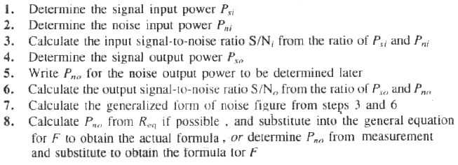
Noise Calculations
The calculation procedure may be broken down into a number of general steps.
Each is now shown, followed by the number of the corresponding equation(s) to follow:
Notes:
Resistance is a concept used for DC (direct currents) whereas impedance is the AC (alternating current) equivalent. Resistance is due to electrons in a conductor colliding with the ionic lattice of the conductor meaning that electrical energy is converted into heat.

Slide 79


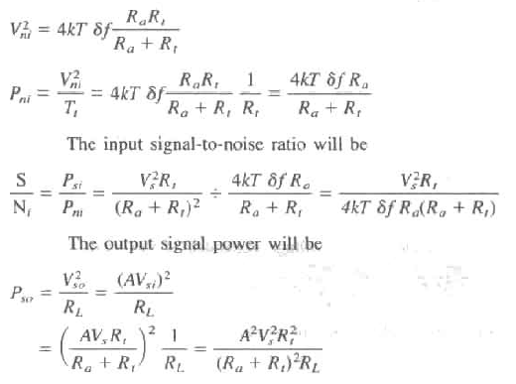
Noise Calculations
The signal input voltage and power will be:
Similarly, the noise input voltage and power will be
Notes:
Resistance is a concept used for DC (direct currents) whereas impedance is the AC (alternating current) equivalent. Resistance is due to electrons in a conductor colliding with the ionic lattice of the conductor meaning that electrical energy is converted into heat.

Slide 80
Noise Calculations
Noise Figure from Equivalent Noise Resistance:
As derived in Equation (2-7), the equivalent noise resistance of an amplifier or receiver is the sum of the input terminating resistance and the equivalent noise resistance of the first stage, together with the noise resistances of the previous stages referred to the input.
Putting it another way, we see that all these resistances are added to R_{t} giving; lumped resistance which is then said to concentrate all the "noise making" of the receiver. The rest of it is now assumed to be noiseless. All this applies here, with the minor exception that these noise resistances must now be added to the parallel combination of R_{a} and R_{t}. In order to correlate noise figure and equivalent noise resistance. It is convenient to define R’_{eq}, which is a noise resistance that does not incorporate R_{t} and which is given by R’_{eq}=R_{eq} – Rt.
Notes:
Resistance is a concept used for DC (direct currents) whereas impedance is the AC (alternating current) equivalent. Resistance is due to electrons in a conductor colliding with the ionic lattice of the conductor meaning that electrical energy is converted into heat.

Slide 81
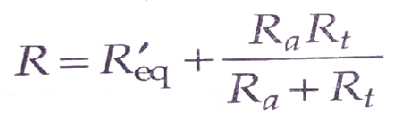
Noise Calculations
The total equivalent noise resistance for this receiver will now be:
Notes:
Resistance is a concept used for DC (direct currents) whereas impedance is the AC (alternating current) equivalent. Resistance is due to electrons in a conductor colliding with the ionic lattice of the conductor meaning that electrical energy is converted into heat.

Slide 82
Noise
With reference to an electrical system, noise may be defined as any unwanted form of energy which tends o interfere with proper reception and reproduction of wanted signal.
Noise is random, undesirable electrical energy that enters the communications system via the communicating medium and interferes with the transmitted message. However, some noise is also produced in the receiver.
Classification of Noise
Noise may be put into following two categories.
External noises. i.e. noise whose sources are external
External noise may be classified into the following three types:
Atmospheric noises
Extraterrestrial noises
Man-made noises or industrial noises.
2. Internal noise In communication, i.e noises which get generated within the receiver or communication system.
Internal noise may be put into the following four categories.
Notes:
Resistance is a concept used for DC (direct currents) whereas impedance is the AC (alternating current) equivalent. Resistance is due to electrons in a conductor colliding with the ionic lattice of the conductor meaning that electrical energy is converted into heat.

Slide 83
Noise
Classification of Noise
Noise may be put into following two categories.
External noises. i.e. noise whose sources are external. External noise may be classified into the following three types:
Atmospheric noises
Extraterrestrial noises
Man-made noises or industrial noises.
Internal noise In communication, i.e. noises which get generated within the receiver or communication system.
Thermal noise or where noise or Johnson noise
Shot noise
Transit time noise
Miscellaneous internal noise.
Notes:
Resistance is a concept used for DC (direct currents) whereas impedance is the AC (alternating current) equivalent. Resistance is due to electrons in a conductor colliding with the ionic lattice of the conductor meaning that electrical energy is converted into heat.

